Slide 1
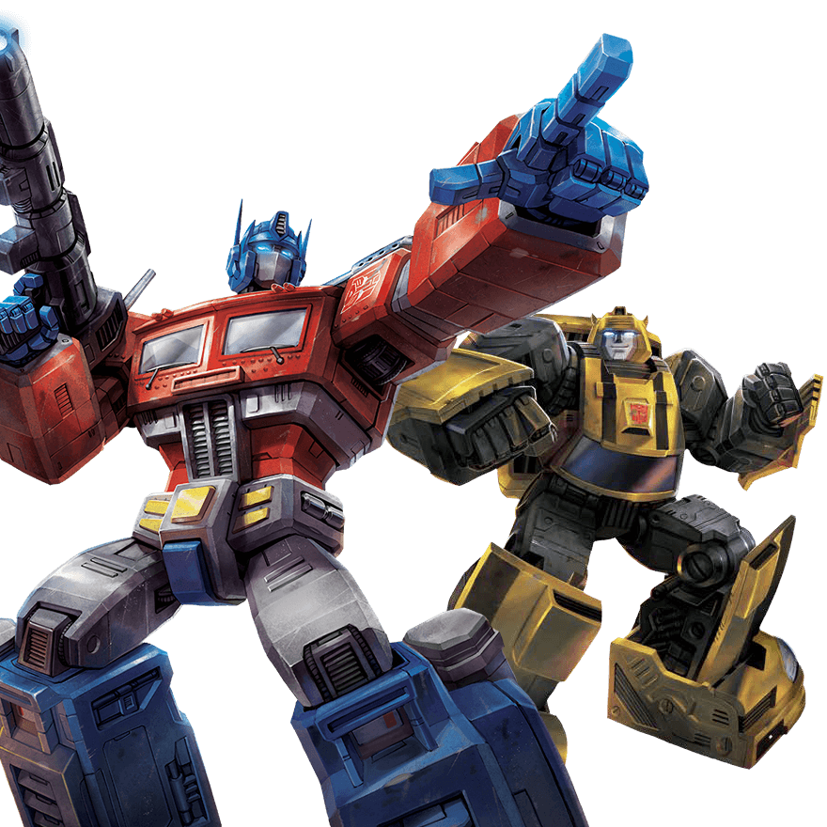

Transformer
BERT
李宏毅
Hung-yi Lee
Notes:
TBD: why not batch norm? why layer norm ?

Slide 2

Sequence-to-sequence (Seq2seq)
Input a sequence, output a sequence
The output length is determined by model.
Speech
Recognition
你
好
嗎
N
T
機
器
學
習
Machine
Translation
machine
learning
N
N’
machine
learning
機
器
學
習
Speech
Translation
Language without text
Notes:
Speech Recognition + Machine Translation
Why don’t we simply concatenate two system?

Slide 3


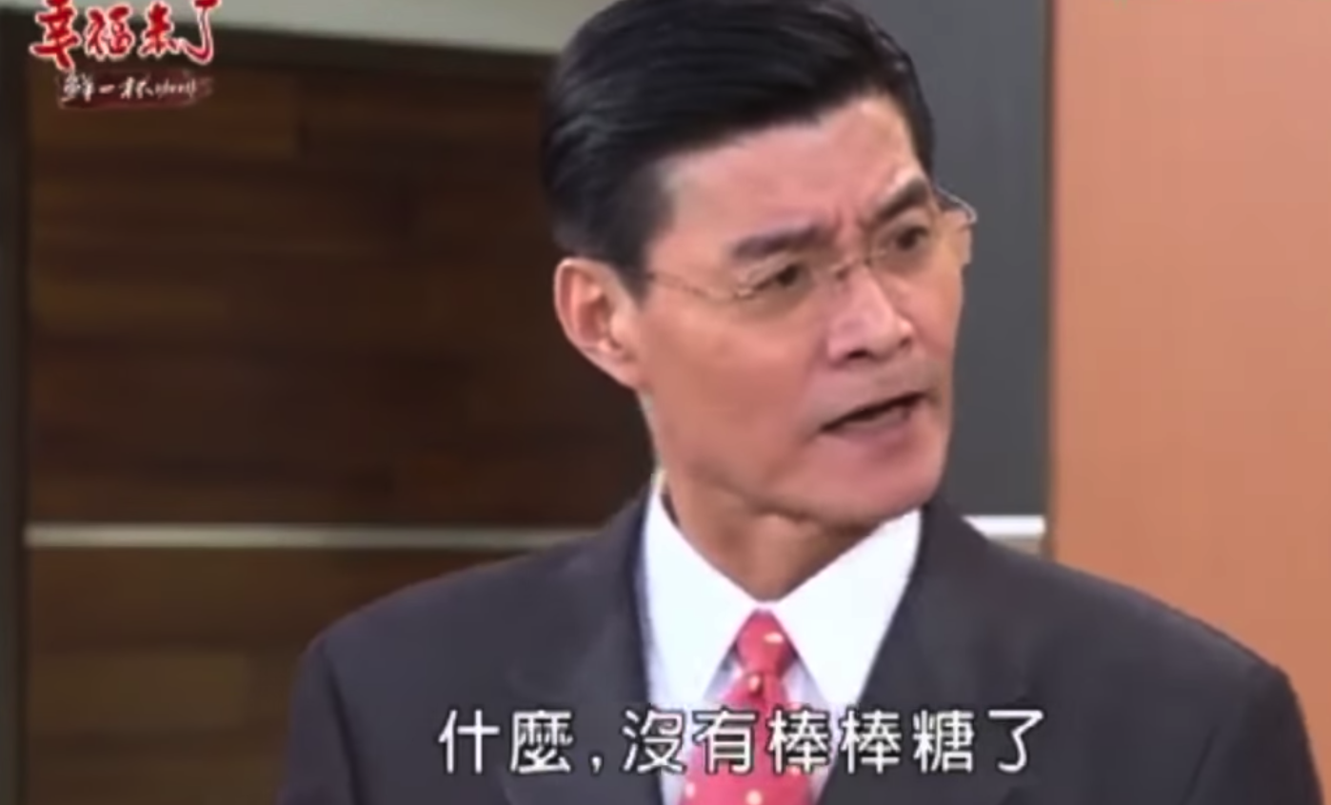
Hokkien (閩南語、台語)
Speech Recognition
“母湯”
??????? …
(Speech of Hokkien)
Speech
Translation
“不行”
(Speech of Hokkien)
Local soap operas (鄉土劇) on YouTube (Speech of Hokkien, Chinese subtitle)
Using 1500 hours of data for training

Slide 4
Hokkien (閩南語、台語)
Background music & noises?
Noisy transcriptions?
Phonemes of Hokkien?
Don’t care …
Don’t care …
No ……
“硬train一發”
(Ying Train Yi Fa)
Notes:
https://ieeexplore.ieee.org/document/8682801/ (ICASSP 2019)

Slide 5

Hokkien (閩南語、台語)
感謝 李仲翊 同學提供實驗結果
你 的 身 體 撐 不 住
沒 事 你 為 什 麼 要 請 假
要 生 了 嗎
Answer:不 會 膩 嗎
我 有 幫 廠 長 拜 託
Answer: 我 拜 託 廠 長 了
To learn more: https://sites.google.com/speech.ntut.edu.tw/fsw/home/challenge-2020
Notes:
https://ieeexplore.ieee.org/document/8682801/ (ICASSP 2019)

Slide 6
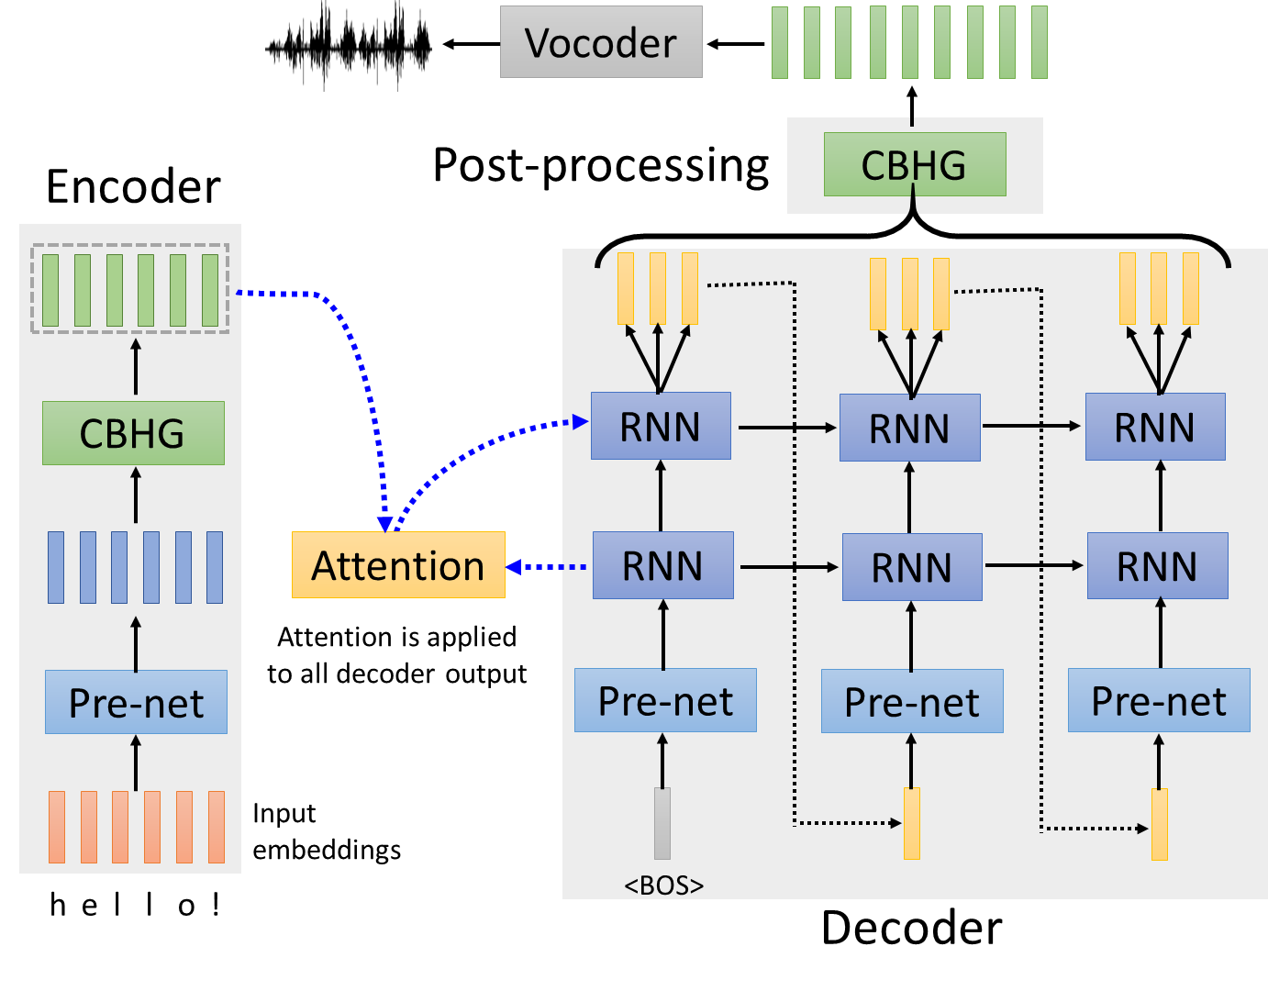
Text-to-Speech (TTS) Synthesis
感謝張凱為同學提供實驗結果
Taiwanese Speech Synthesis
Source of data: 台灣媠聲2.0
歡迎來到台大語音處理實驗室
最近肺炎真嚴重，要記得戴口罩、勤洗手，有病就要看醫生
Notes:
可能需要試一下能不能跑出來

Slide 7
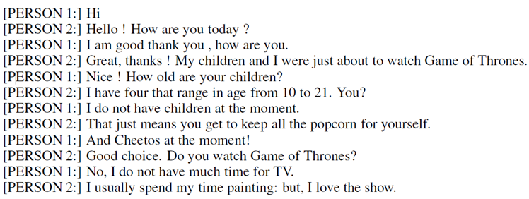
Seq2seq for Chatbot
“Hello! How are you today?”
seq2seq
input
response
“Hi”
Training
data:
Notes:
https://youtu.be/mk6v2raVGfk

Slide 8
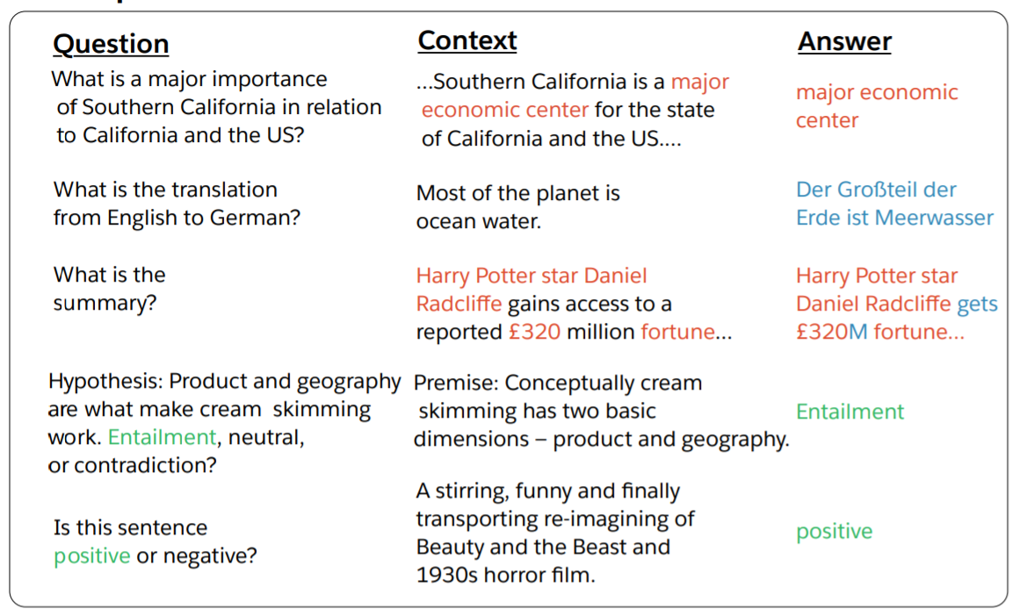
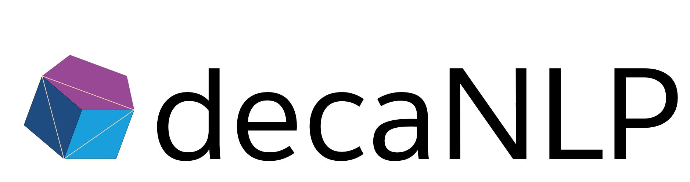
Most Natural Language Processing applications …
Question Answering (QA)
(sentiment analysis)
QA can be done by seq2seq
Seq2seq
question, context
answer
https://arxiv.org/abs/1806.08730
https://arxiv.org/abs/1909.03329

Slide 9
Seq2seq for Syntactic Parsing
Is it a sequence?
S
Model
Output
VP
NP
ADJV
Model
Input
deep learning is very powerful
Notes:
Oriol Vinyals
https://arxiv.org/abs/1412.7449
Of course, you can try other tree traversal approaches
state-of-the-art results …

Slide 10
Seq2seq for Syntactic Parsing
(S
(NP
deep
learning
)
(VP
is
(ADJV
very
powerful
)
)
)
Seq2seq!
S
VP
NP
ADJV
deep learning is very powerful
Notes:
Oriol Vinyals
https://arxiv.org/abs/1412.7449
Of course, you can try other tree traversal approaches
state-of-the-art results …

Slide 11
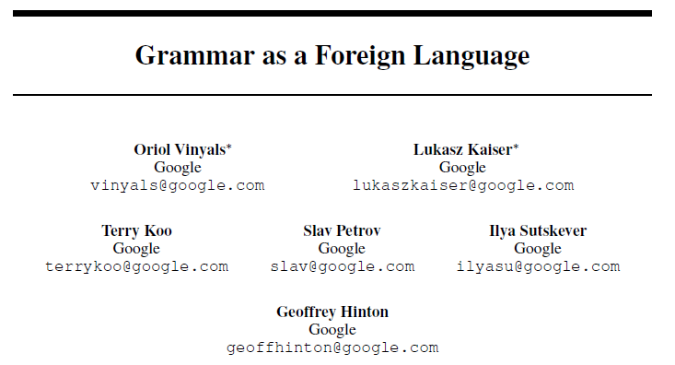
Seq2seq for Syntactic Parsing
(S
(NP
deep
learning
)
(VP
is
(ADJV
very
powerful
)
)
)
https://arxiv.org/abs/1412.7449
deep learning is very powerful
Notes:
Oriol Vinyals
https://arxiv.org/abs/1412.7449
Of course, you can try other tree traversal approaches
state-of-the-art results …

Slide 12
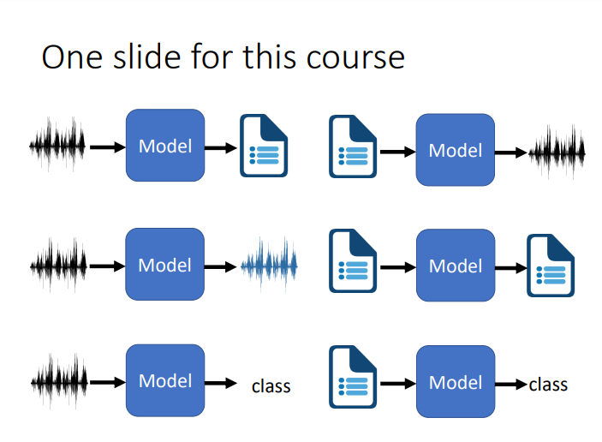
Deep Learning for Human Language Processing
深度學習與人類語言處理
Source webpage: https://speech.ee.ntu.edu.tw/~hylee/dlhlp/2020-spring.html

Slide 13

Seq2seq for Multi-label Classification
c.f. Multi-class Classification
An object can belong to multiple classes.
Class 1
Class 1
Class 3
Class 10
Class 3
Class 9
Class 17
Seq2seq
Class 9
Class 7
Class 13
https://arxiv.org/abs/1909.03434
https://arxiv.org/abs/1707.05495

Slide 14
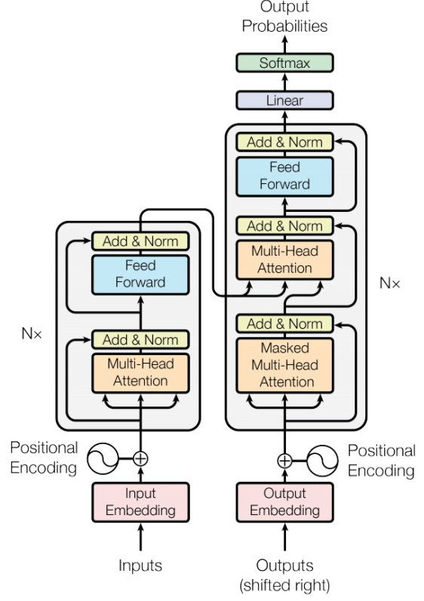

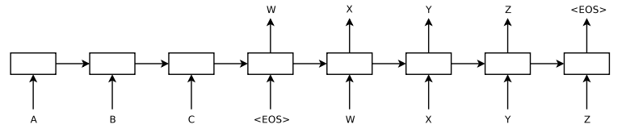
Seq2seq
output sequence
Encoder
Decoder
Input sequence
Sequence to Sequence Learning with Neural Networks
Transformer
https://arxiv.org/abs/1409.3215
https://arxiv.org/abs/1706.03762
Notes:
Sequence to Sequence Learning with Neural Networks
Ilya Sutskever, Oriol Vinyals, Quoc V. Le

Slide 15
Encoder
output sequence
Encoder
Decoder
Input sequence

Slide 16
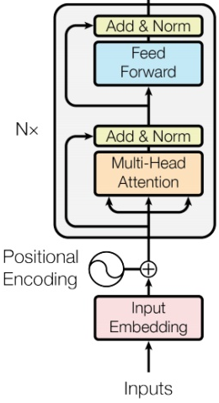








Encoder
Transformer’s Encoder
You can use RNN or CNN.
$$h^{1}$$
$$h^{2}$$
$$h^{3}$$
$$h^{4}$$
Encoder
$$x^{1}$$
$$x^{2}$$
$$x^{3}$$
$$x^{4}$$
Notes:
可以用 CNN, RNN
不用拘泥於 Transformer’s Encoder

Slide 17








$$h^{1}$$
$$h^{2}$$
$$h^{3}$$
$$h^{4}$$
Block
…
…
…
…
FC
FC
FC
FC
Block
Block
Self-attention
$$x^{1}$$
$$x^{2}$$
$$x^{3}$$
$$x^{4}$$

Slide 18


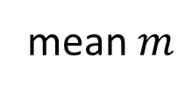





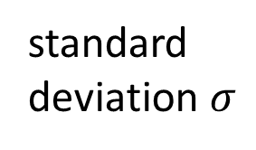
…
$$\left[\begin{aligned}x_{1}^{′} \\ x_{2}^{′} \\ ⋮ \\ x_{K}^{′}\end{aligned}\right]$$
$$x_{i}^{′}=\frac{x_{i}^{′}−m}{σ}$$
norm
Layer Norm
norm
norm
https://arxiv.org/abs/1607.06450
+
residual
$$a+b$$
$$\left[\begin{aligned}x_{1} \\ x_{2} \\ ⋮ \\ x_{K}\end{aligned}\right]$$
mean $m$
FC
standard deviation $σ$
$$b$$
+
$$a$$
Self-attention

Slide 19

BERT
I use the same network architecture as transformer encoder.
$$h^{1}$$
$$h^{2}$$
$$h^{3}$$
$$h^{4}$$
Encoder
Residue
+ Layer norm
$$x^{1}$$
$$x^{2}$$
$$x^{3}$$
$$x^{4}$$

Slide 20
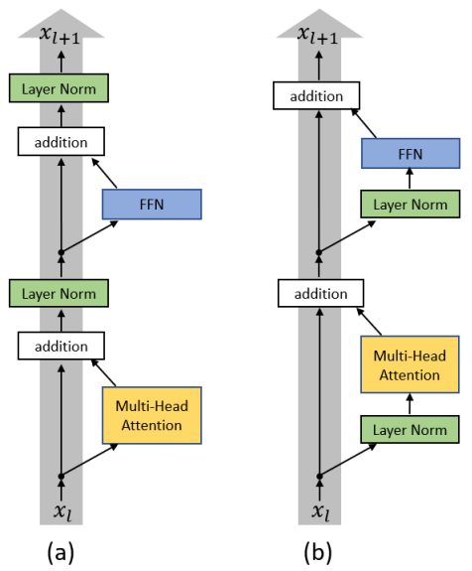
To learn more ……
On Layer Normalization in the Transformer Architecture
https://arxiv.org/abs/2002.04745
PowerNorm: Rethinking Batch Normalization in Transformers
https://arxiv.org/abs/2003.07845
Notes:
Why not BN?
https://arxiv.org/pdf/2003.07845.pdf
=======
This is about initialization
https://arxiv.org/pdf/1908.11365.pdf

Slide 21
Decoder
output sequence
Encoder
Decoder
Input sequence

Slide 22
Decoder – Autoregressive (AT)
output sequence
Encoder
Decoder
Input sequence

Slide 23
Autoregressive
distribution
(Speech Recognition as example)
學 | 0.0
機 | 0.8
器 | 0.0
習 | 0.1
…… | ……
機
Size V
max
(common characters)
softmax
Encoder
Decoder
( 機器學習 )
(special token)
START
Notes:
What is BOS?

Slide 24
Autoregressive
機
器
學
習
max
max
max
max
Encoder
Decoder
( 機器學習 )
START
機
器
學
Notes:
What is BOS?

Slide 25
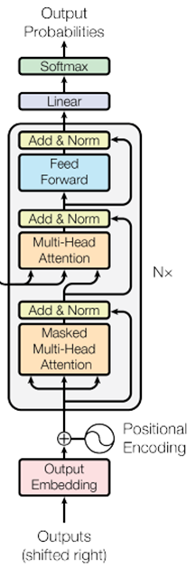
ignore the input from the encoder here ☺
機
器
學
習
max
max
max
max
Decoder
START
機
器
學
Notes:
What is BOS?

Slide 26
Encoder
Decoder

Slide 27








Self-attention
Masked Self-attention
$$b^{1}$$
$$b^{2}$$
$$b^{3}$$
$$b^{4}$$
$$a^{1}$$
$$a^{2}$$
$$a^{3}$$
$$a^{4}$$
Can be either input or a hidden layer
Notes:
Masked: attend on the generated sequence

Slide 28

















Self-attention
Masked Self-attention
$$b^{2}$$
$$α_{2,1}^{′}$$
$$α_{2,2}^{′}$$
$$α_{2,3}^{′}$$
$$α_{2,4}^{′}$$
$$q^{1}$$
$$k^{1}$$
$$v^{1}$$
$$q^{2}$$
$$k^{2}$$
$$v^{2}$$
$$q^{3}$$
$$k^{3}$$
$$v^{3}$$
$$q^{4}$$
$$k^{4}$$
$$v^{4}$$
$$a^{1}$$
$$a^{2}$$
$$a^{3}$$
$$a^{4}$$
Consider how does decoder work
Why masked?
Notes:
Relation between attention and CNN
Global receptive field (compared to convolutional architectures)

Slide 29
Autoregressive
Question?
Error propagation
Distribution as input?
氣
?
?
(e.g. chatbot, TTS)
機
器
學
習
sample?
max
max
max
max
Encoder
Decoder
?
( 機器學習 )
START
器
學
機
氣
Notes:
What is BOS?

Slide 30
Autoregressive
We do not know the correct output length.
Never stop!
機
器
學
習
慣
……
max
max
max
max
max
Encoder
Decoder
( 機器學習 )
START
機
器
學
習

Slide 31
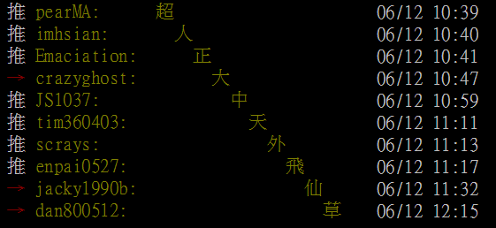
推文接龍 (Tweet Solitaire)
推 tlkagk: =========斷==========
Notes:
接龍推文是ptt在推文中的一種趣味玩法，與推齊有些類似但又有所不同，是指在推文中接續上一樓的字句，而推出連續的意思。該類玩法確切起源已不可知(鄉民百科)

Slide 32
distribution
Adding “Stop Token”
學 | 0.0
機 | 0.8
器 | 0.0
習 | 0.1
…… | ……
END | 0.0
Size V
(common characters)
softmax
Encoder
Decoder
機 器 學 習
START
Notes:
What is BOS?

Slide 33
Autoregressive
Stop at here!
機
器
學
習
END
max
max
max
max
max
Encoder
Decoder
( 機器學習 )
START
機
器
學
習

Slide 34
Decoder – Non-autoregressive (NAT)
output sequence
Encoder
Decoder
Input sequence

Slide 35

AT v.s. NAT
w₁
w₃
w₁
END
w₂
END
w₂
w₃
w₄
AT Decoder
NAT Decoder
START
w₁
w₂
w₃
START
START
START
START
How to decide the output length for NAT decoder?
Another predictor for output length
Output a very long sequence, ignore tokens after END
Advantage: parallel, more stable generation (e.g., TTS)
(why? Multi-modality)
NAT is usually worse than AT

Slide 36
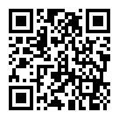
To learn more ……
https://youtu.be/jvyKmU4OM3c
(in Mandarin)

Slide 37
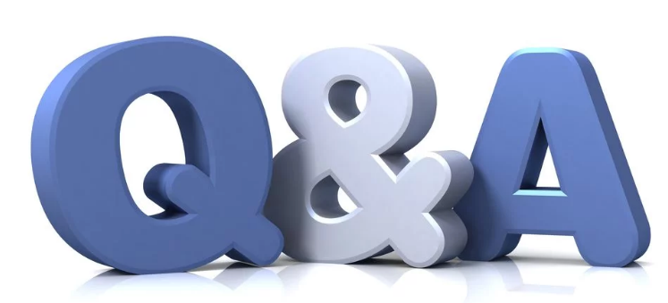

Slide 38
Encoder-Decoder
output sequence
Encoder
Decoder
Input sequence

Slide 39
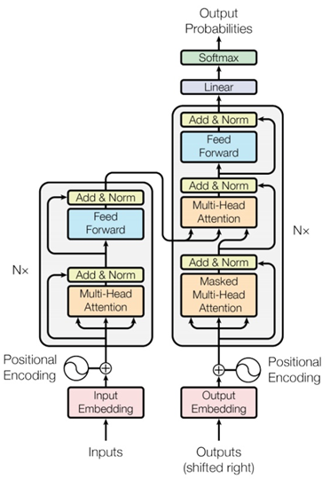
Notes:
I need to know consider which layer?

Slide 40
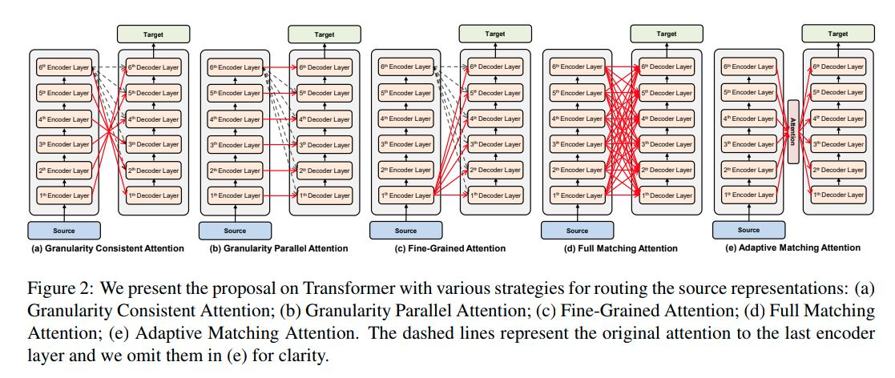
Notes:
https://arxiv.org/pdf/2005.08081.pdf?fbclid=IwAR3R4ezzOjQ0JN_dyH0RTbDJDuFKVgHdSPr30hCKAX58Q40OkAV72nlMSxE

Slide 41
Training
output sequence
Encoder
Decoder
Input sequence

Slide 42
Training
distribution
學 | 0.1
機 | 0.7
器 | 0.1
鬼 | 0.1
…… | ……
Size V
(common characters)
softmax
Encoder
Decoder
Label: 機 器 學 習
<BOS>
Notes:
What is BOS?

Slide 43
學 | 0
機 | 1
器 | 0
鬼 | 0
…… | ……
Ground truth
distribution
機
學 | 0.1
機 | 0.7
器 | 0.1
鬼 | 0.1
…… | ……
Size V
minimize cross entropy
(common characters)
softmax
Encoder
Decoder
Label: 機 器 學 習
<BOS>
Notes:
What is BOS?

Slide 44
機
器
學
習
minimize cross entropy
Encoder
Decoder
Label: 機 器 學 習
<BOS>
機
器
學
Notes:
What is BOS?

